Slide 1
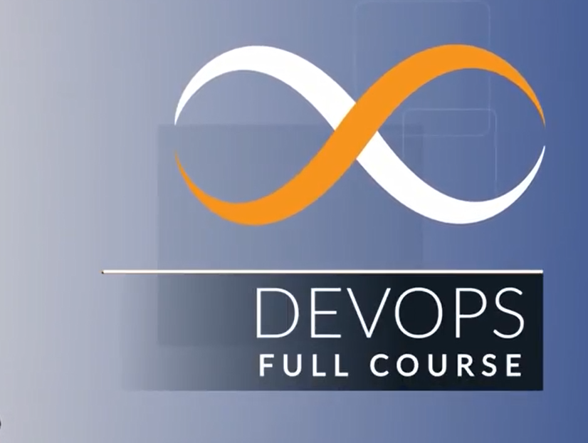

Slide 2
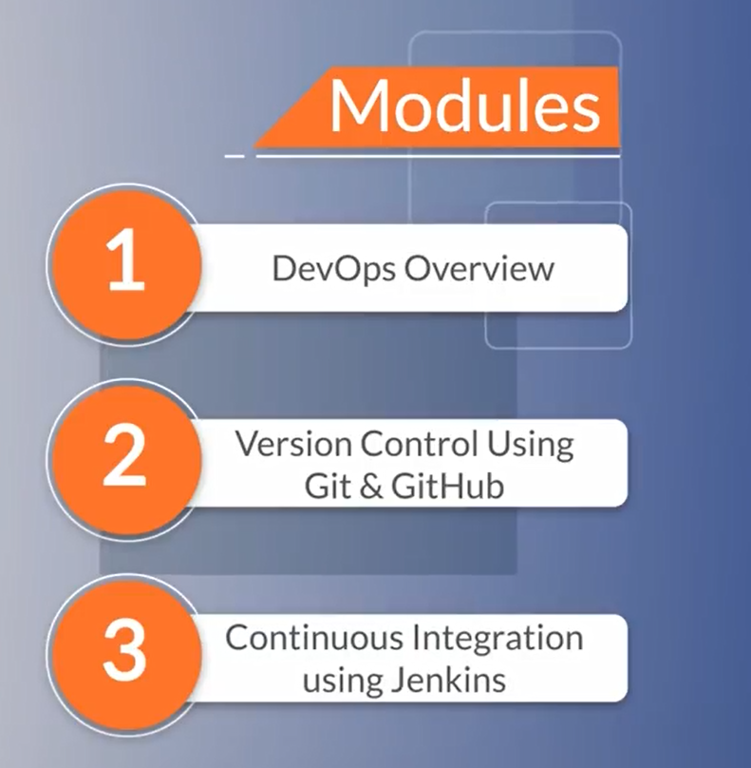

Slide 3
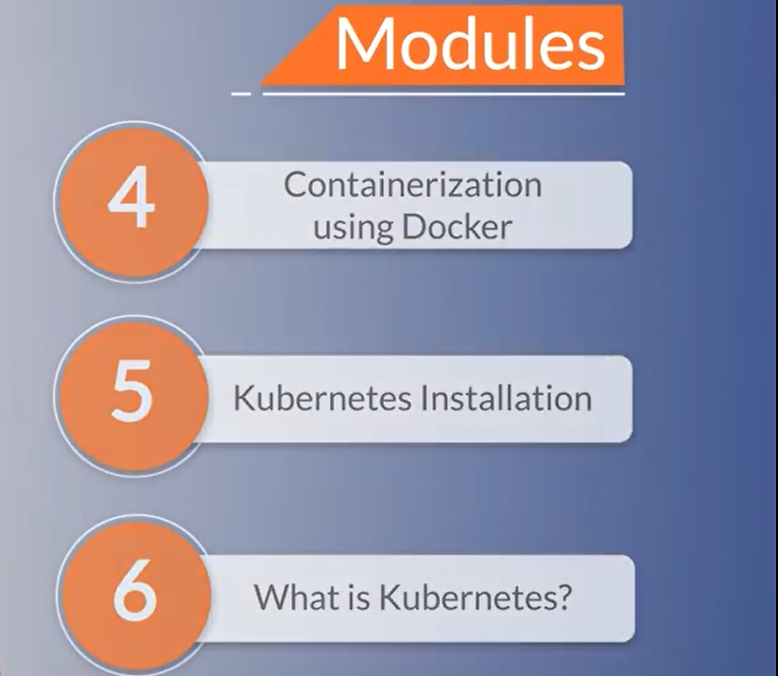

Slide 4
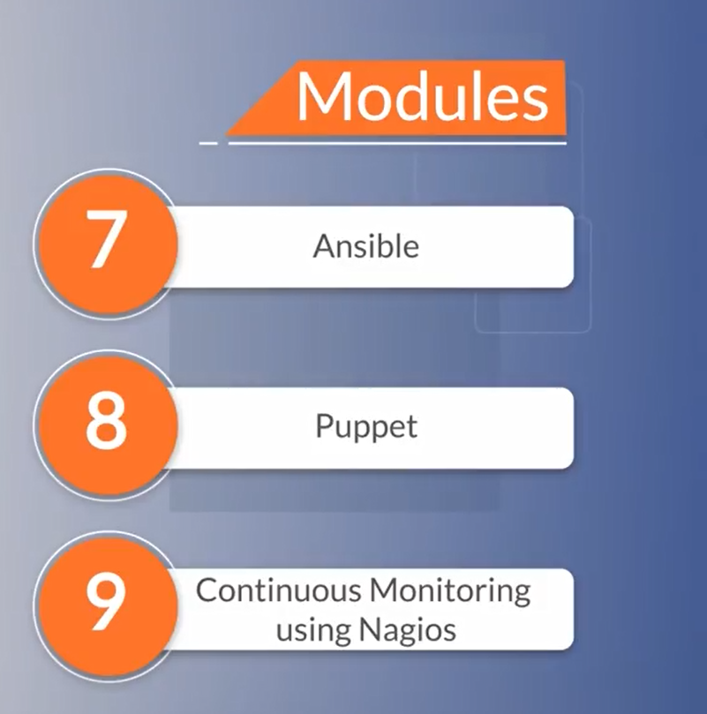

Slide 5
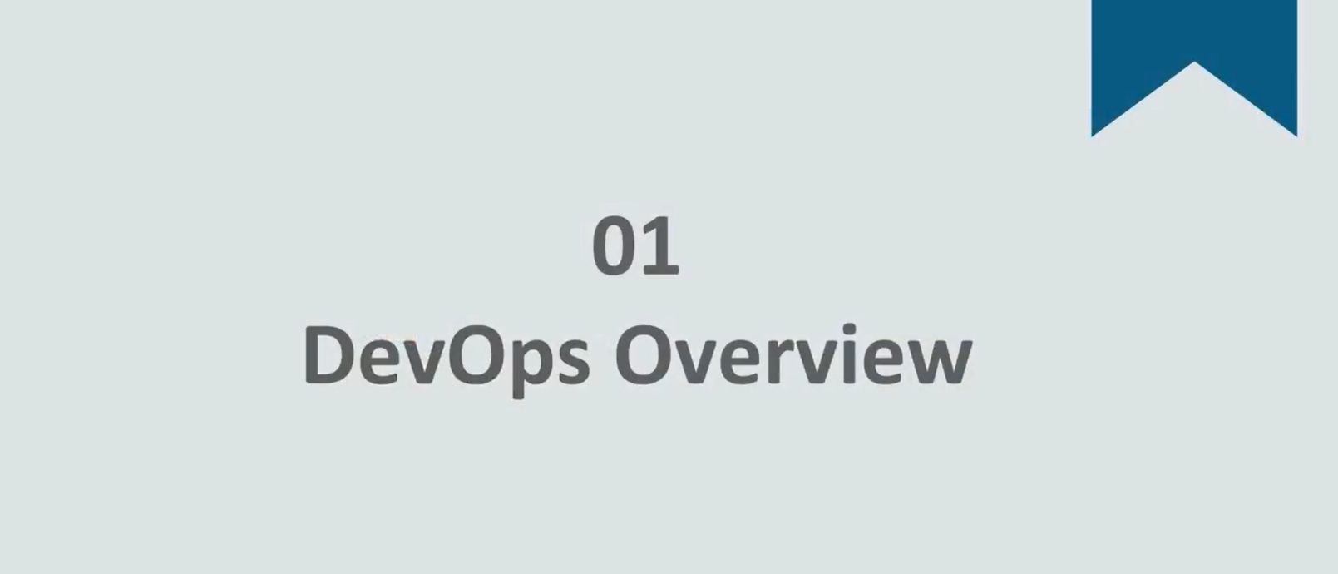

Slide 6
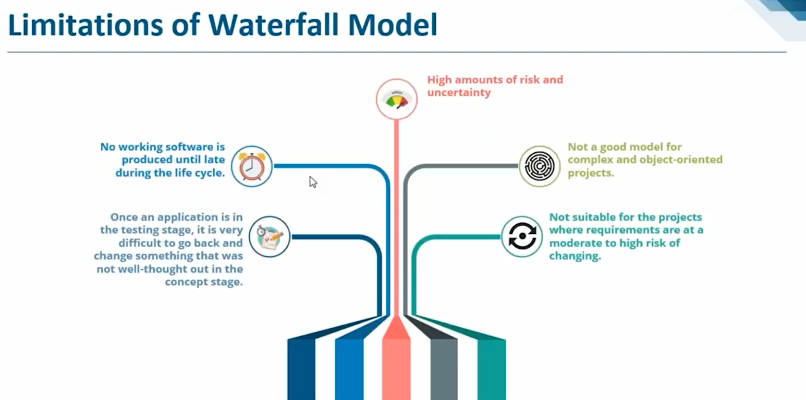

Slide 7
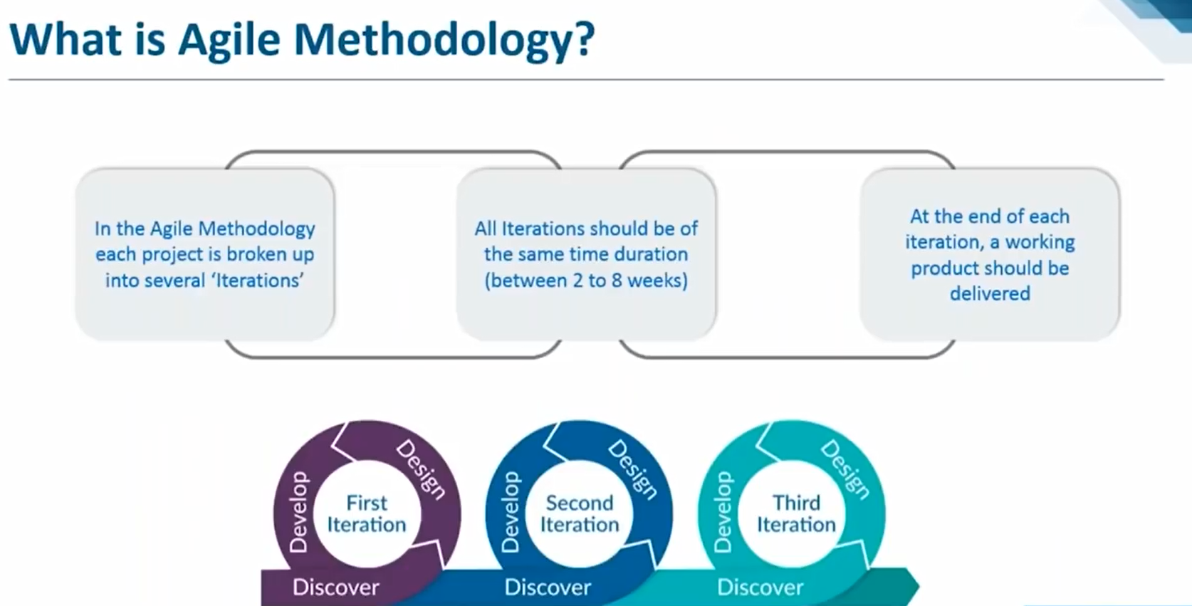

Slide 8
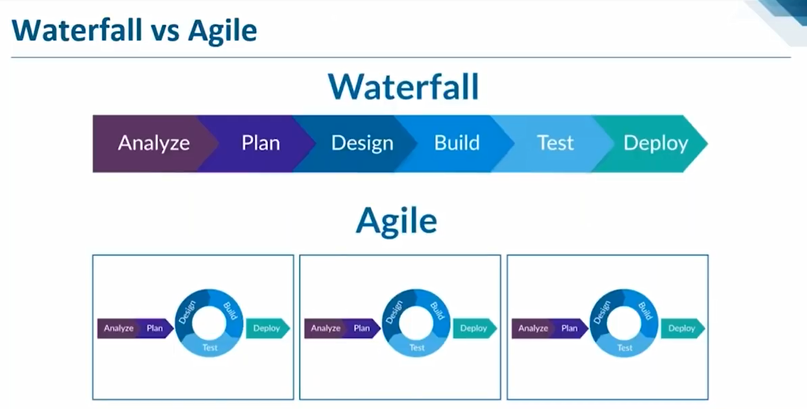

Slide 9
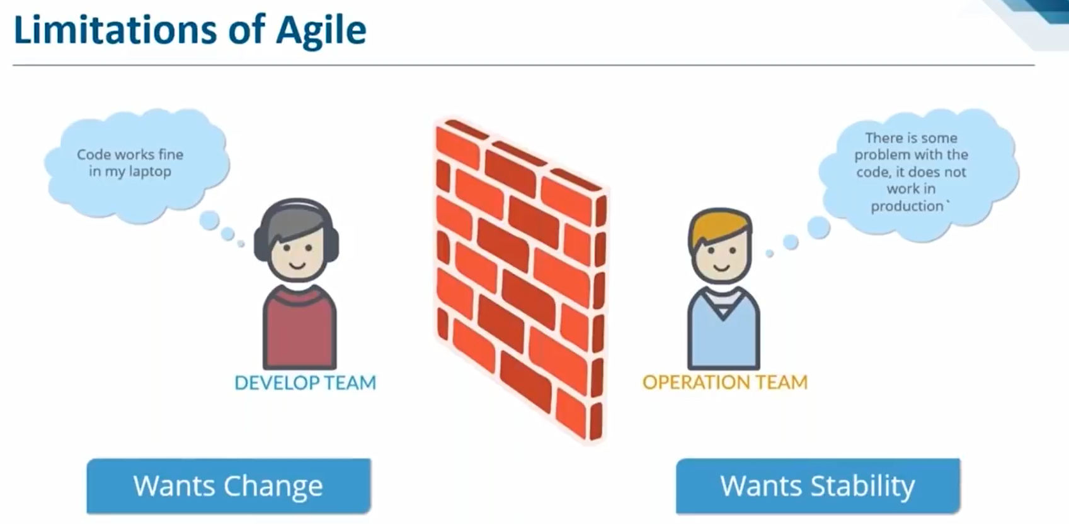

Slide 10
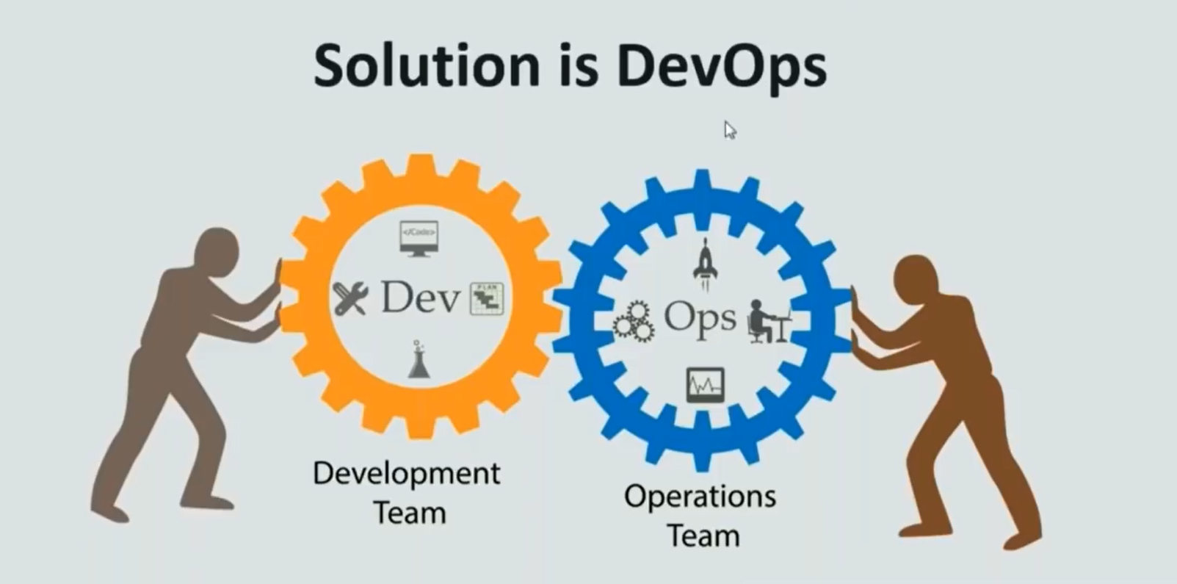

Slide 11
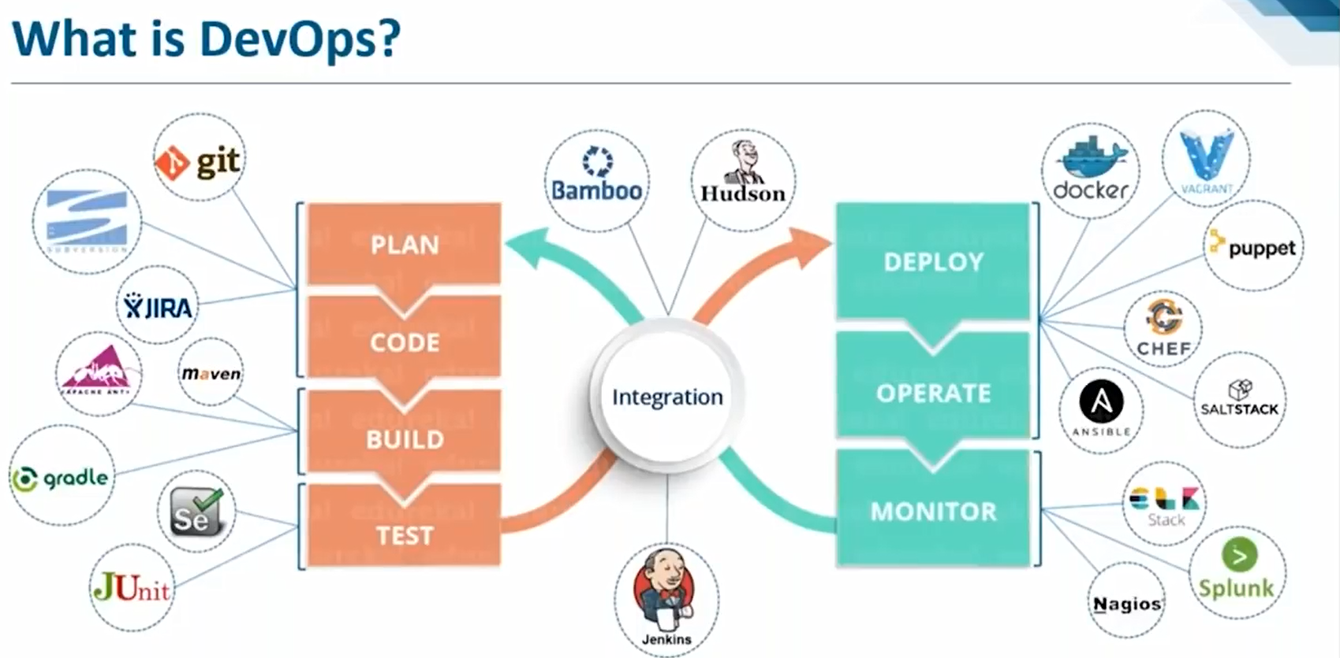

Slide 12
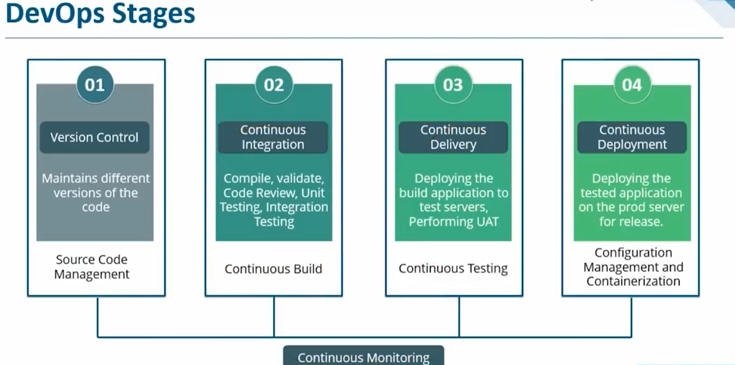
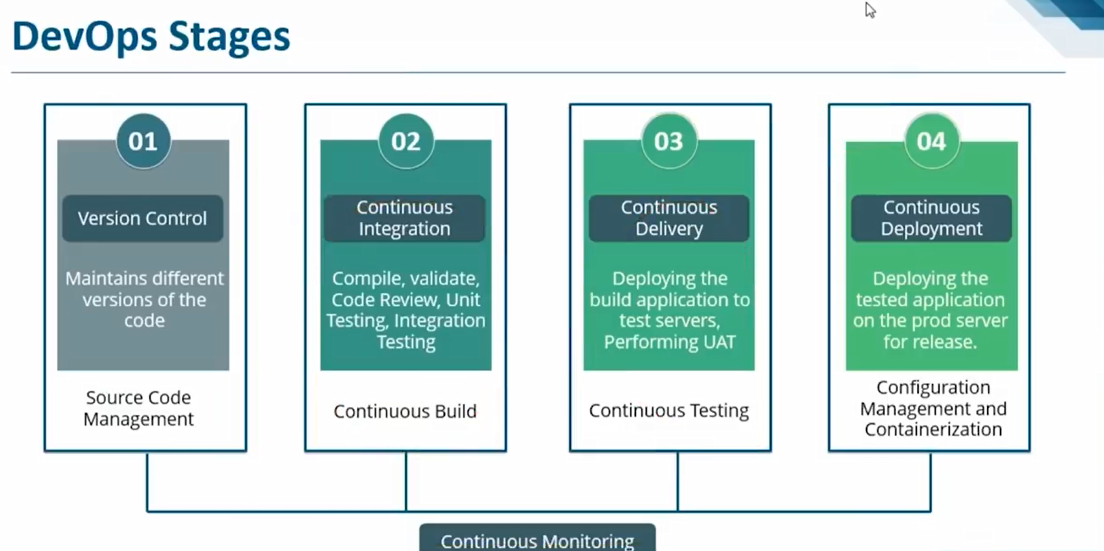

Slide 13
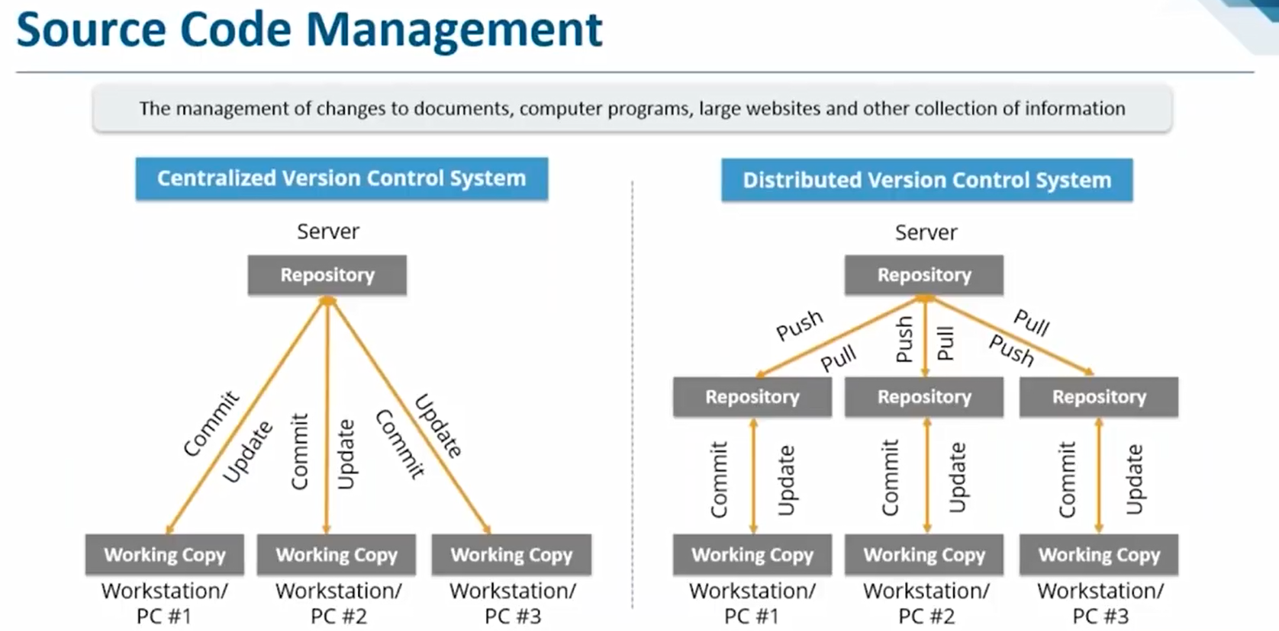


Slide 14
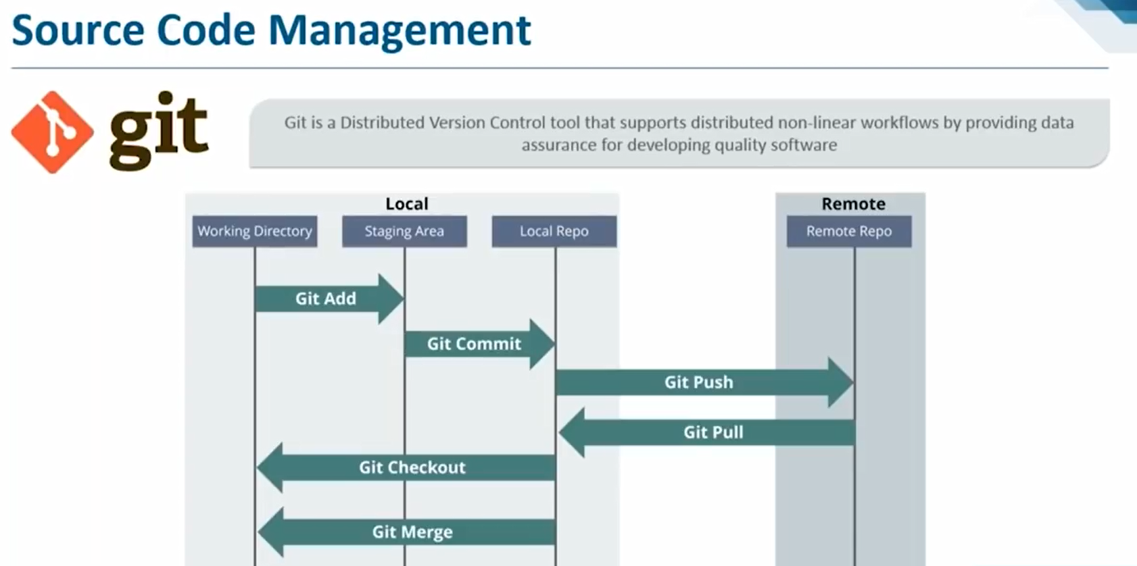

Slide 15
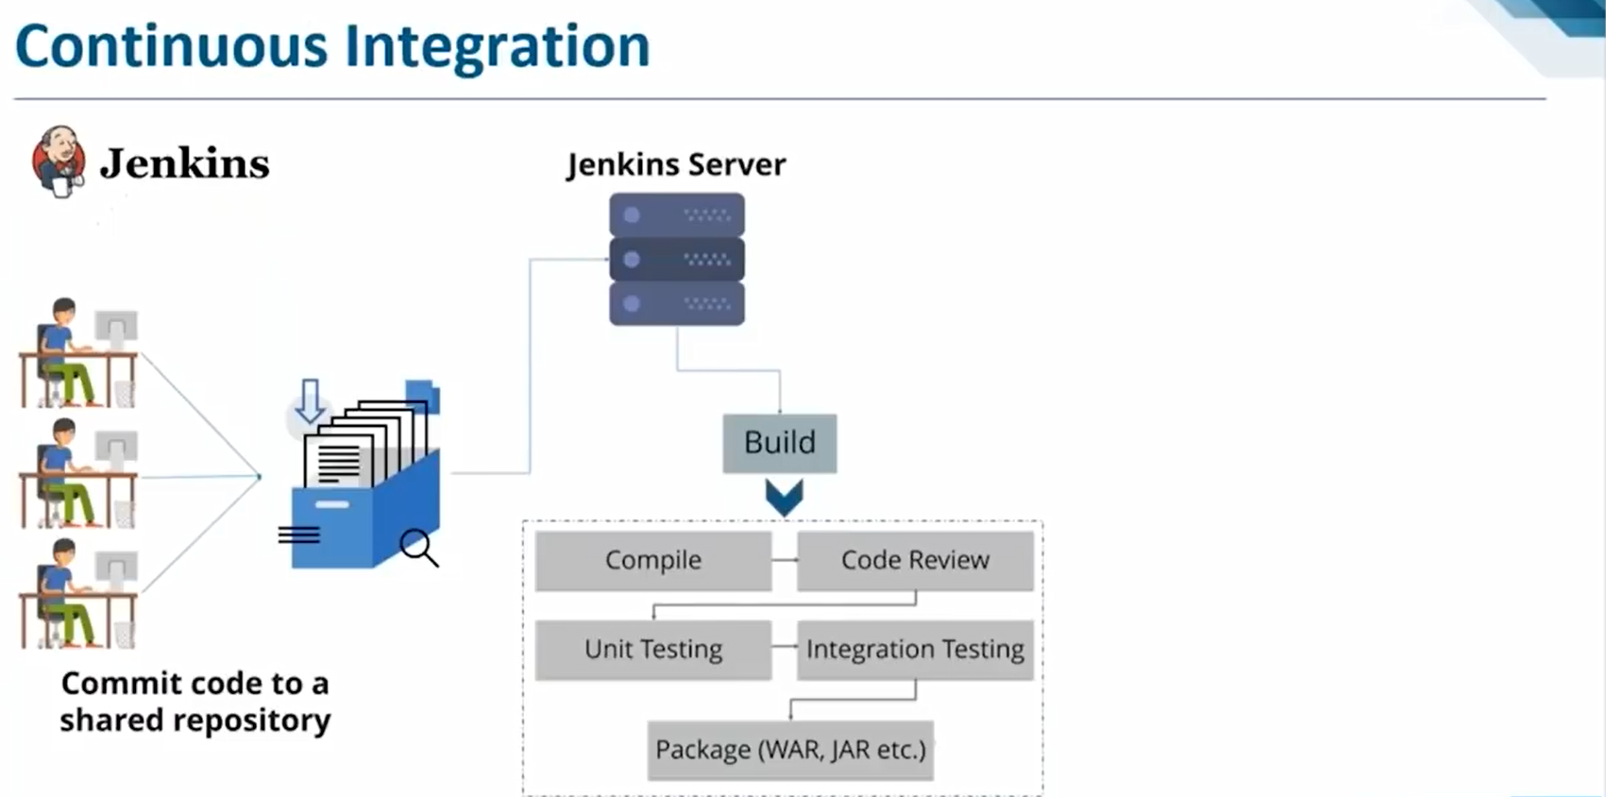

Slide 16
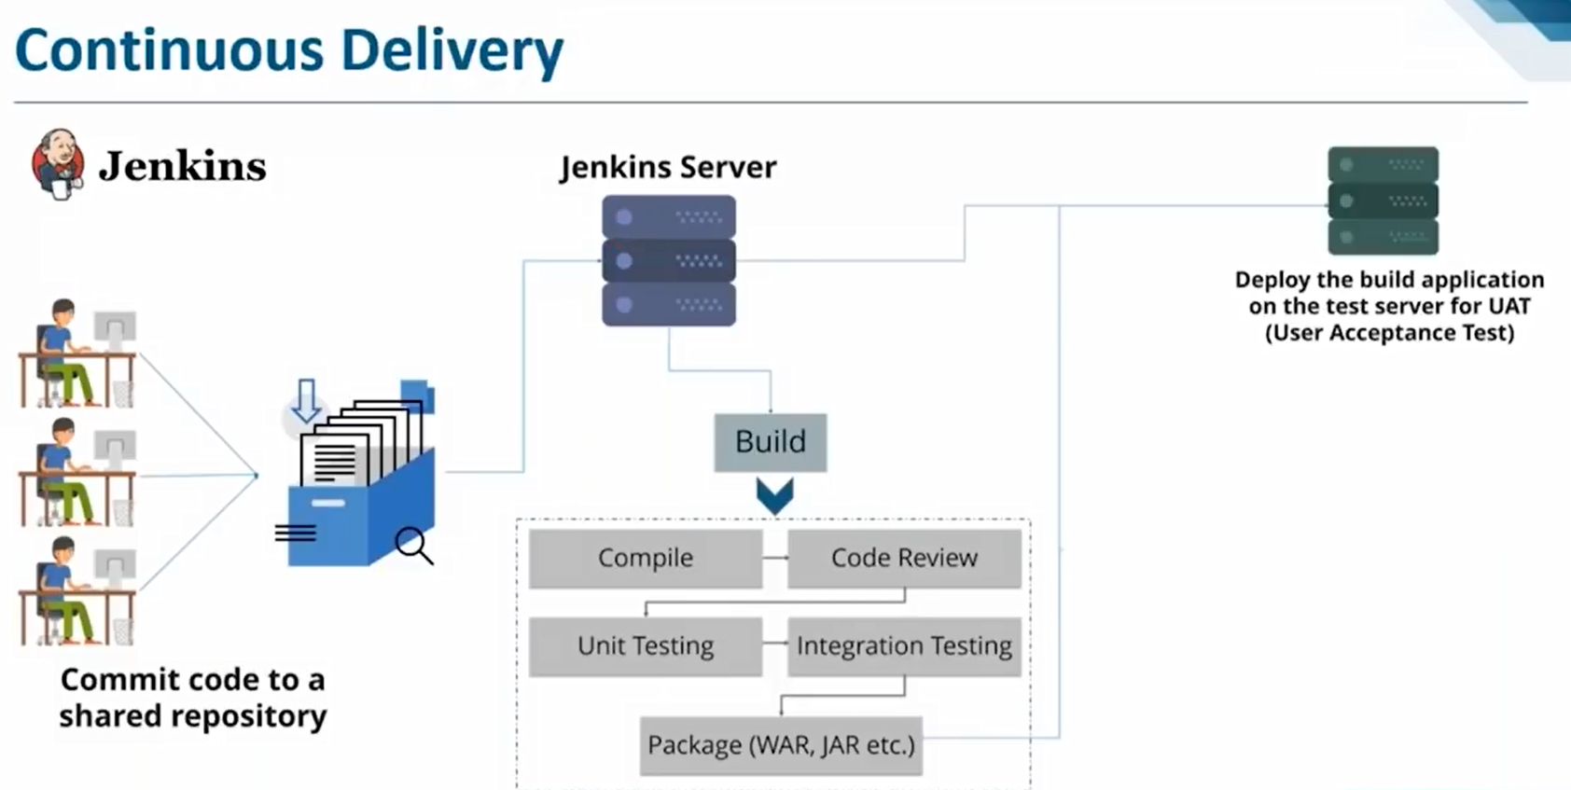

Slide 17
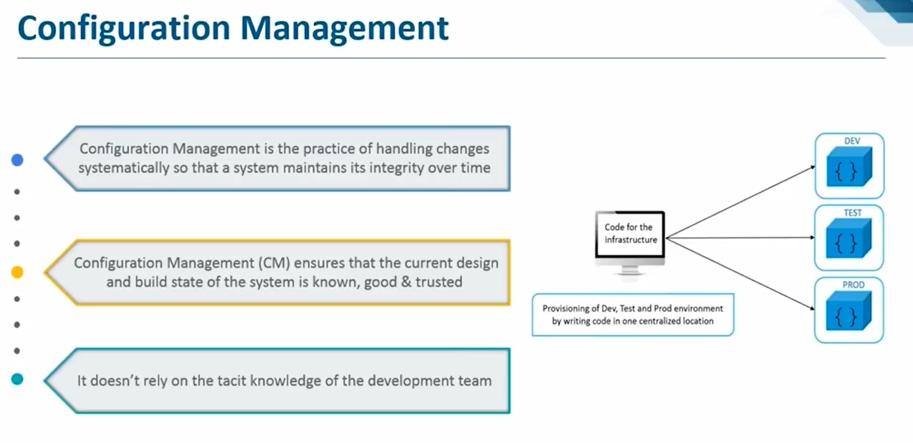

Slide 18
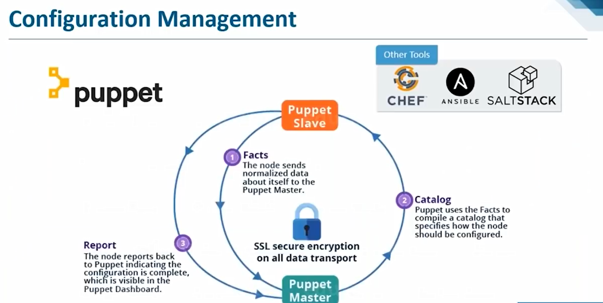

Slide 19
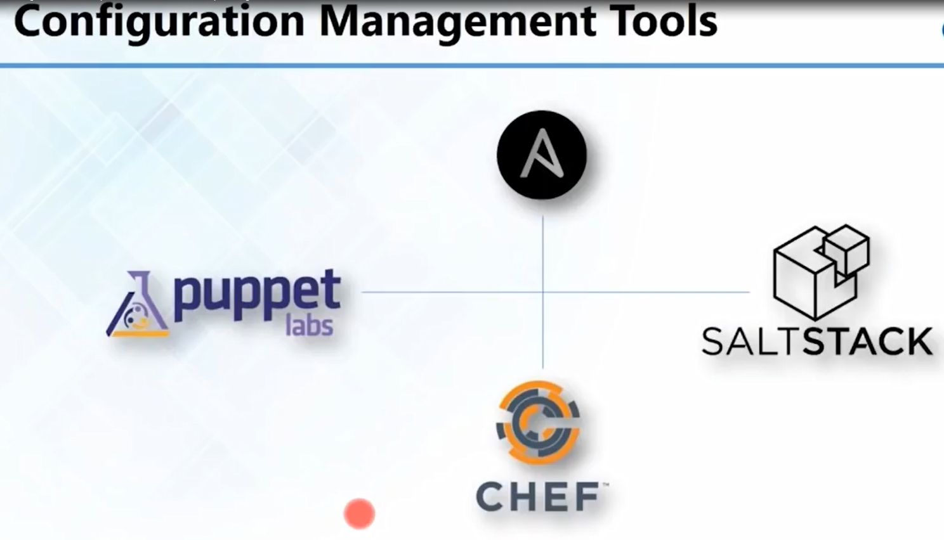

Slide 20
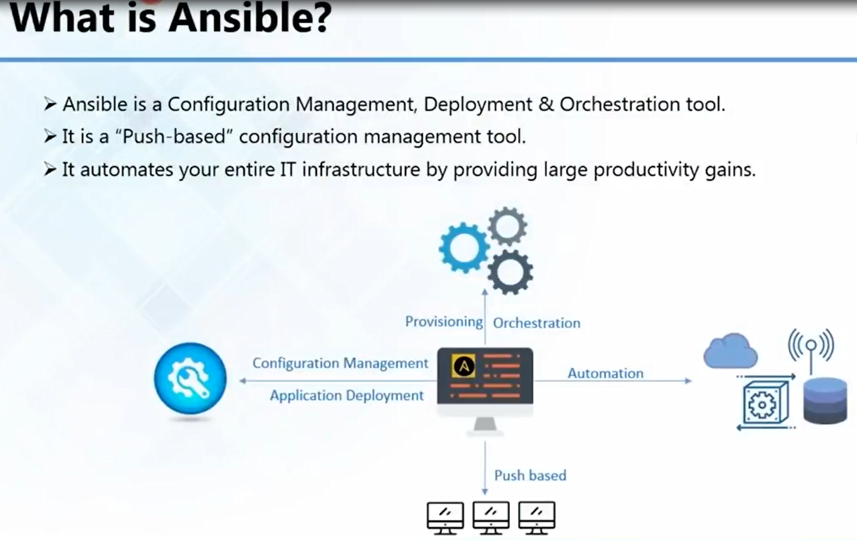

Slide 21
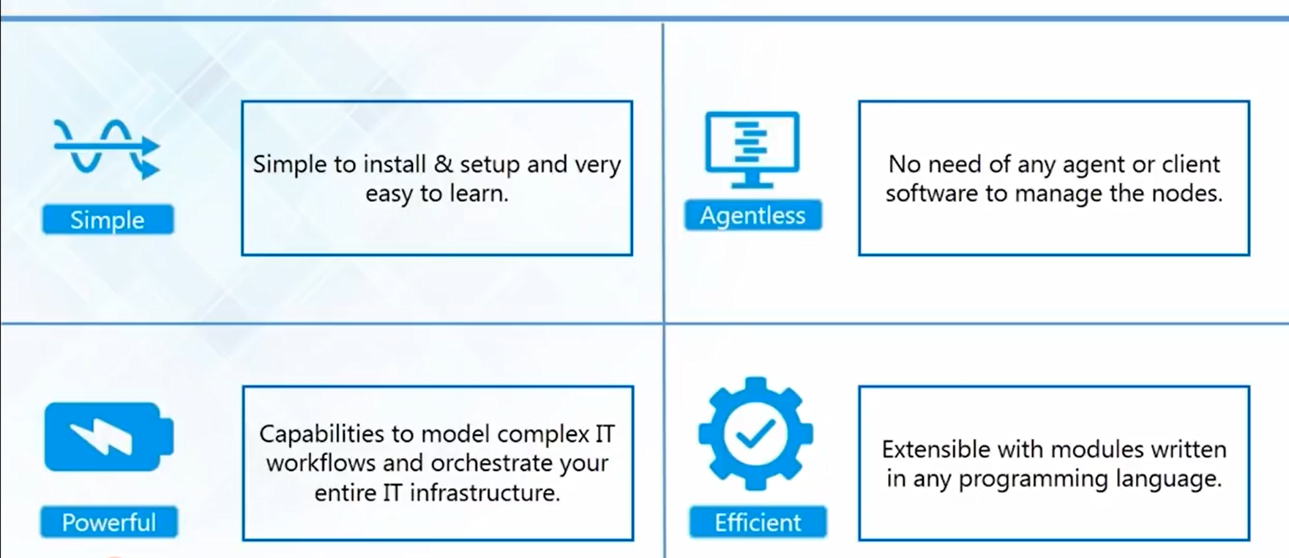
Features of Ansible

Slide 22
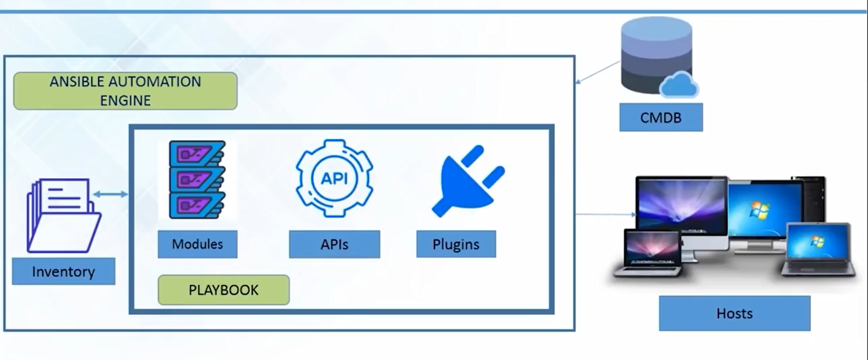

Ansible Architecture

Slide 23
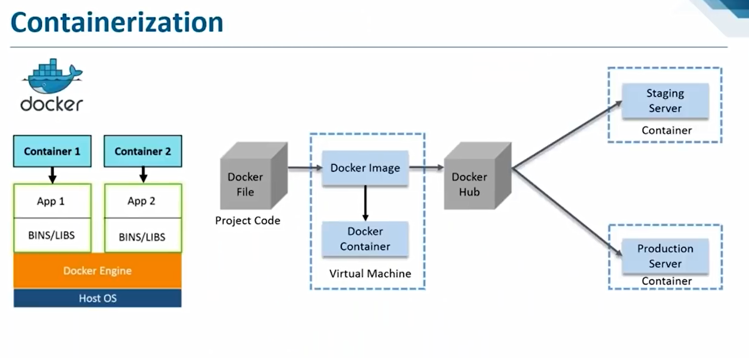

Slide 24
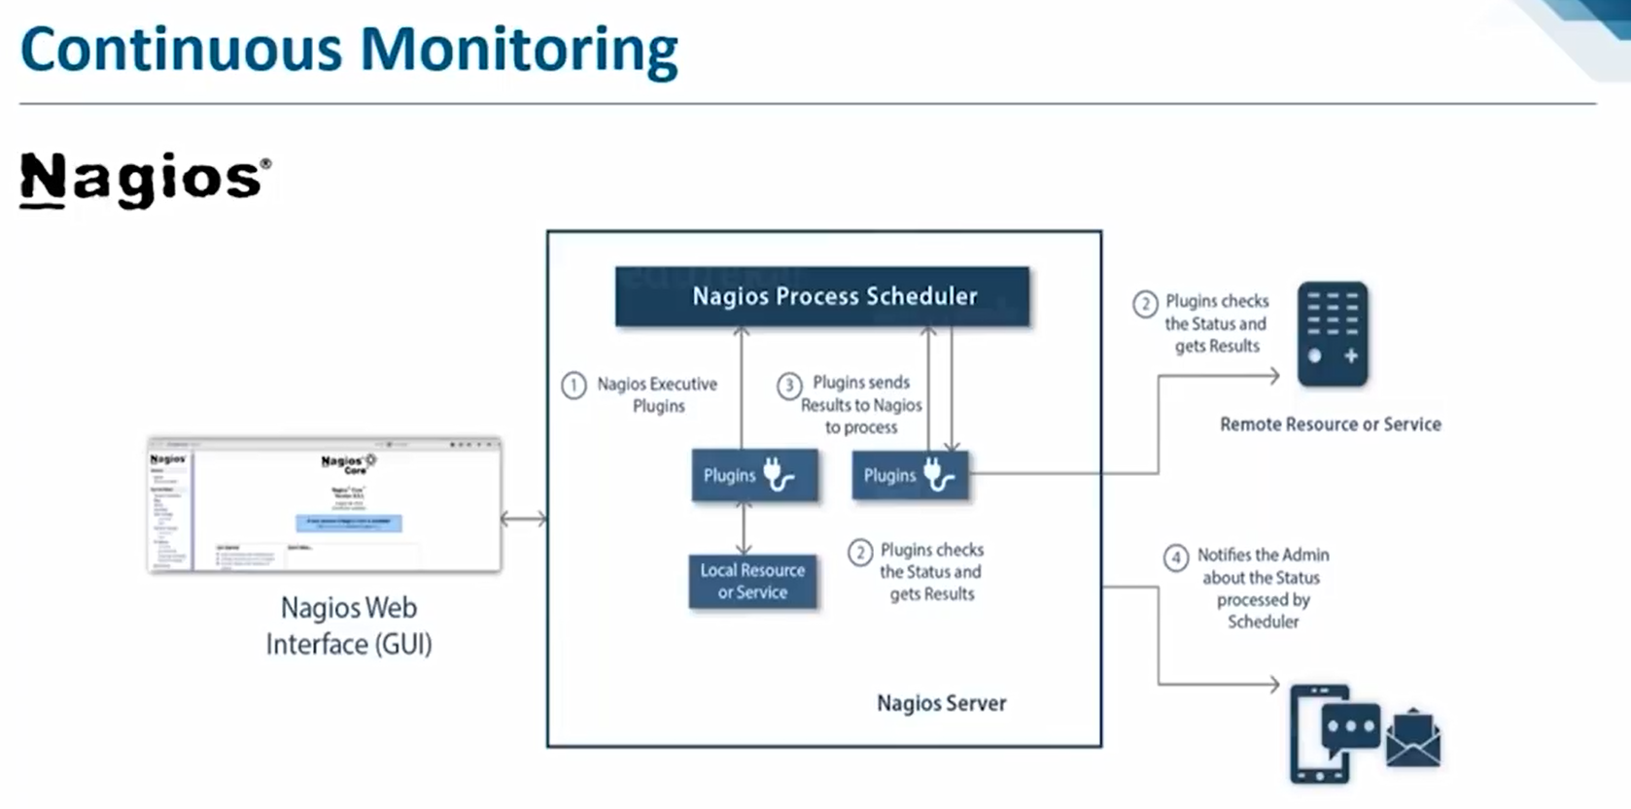

Slide 25
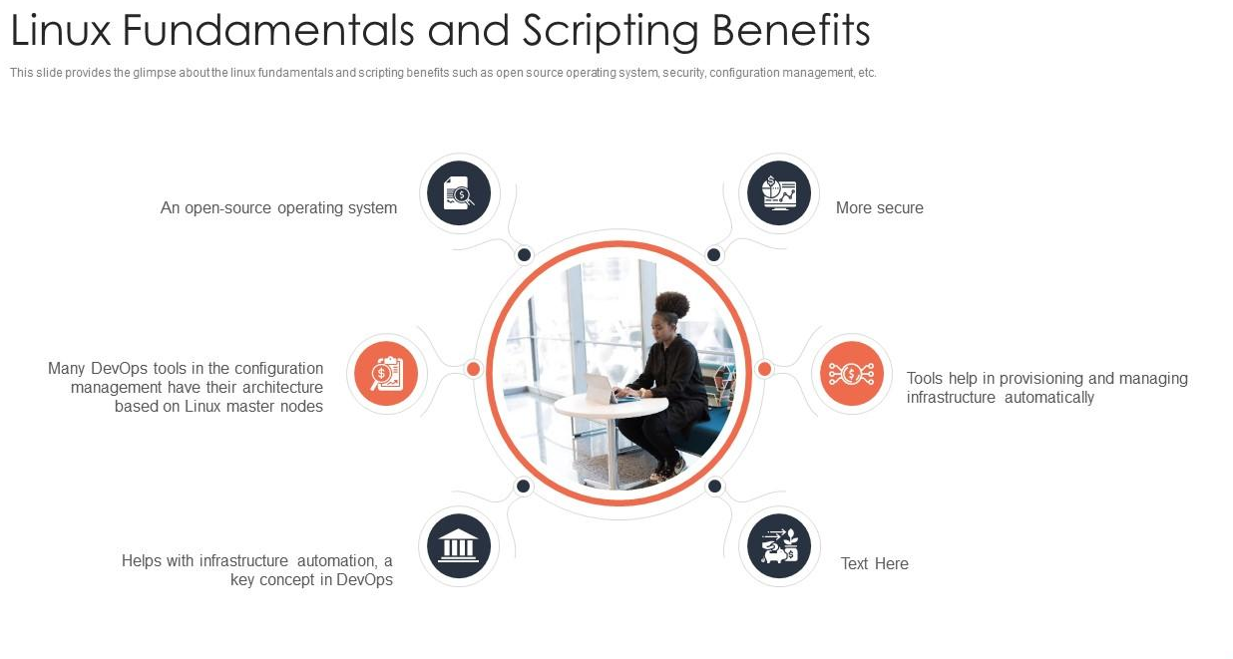

Slide 26
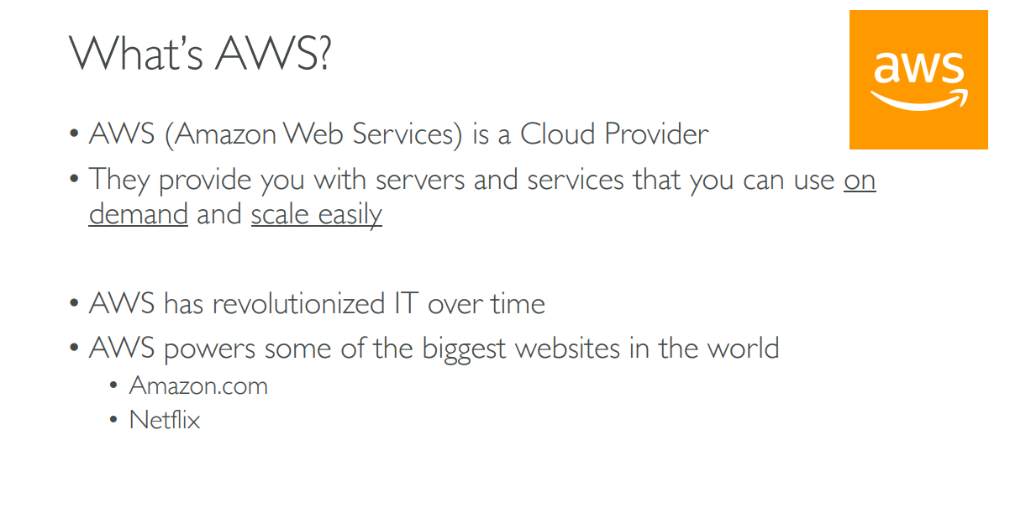

Slide 27
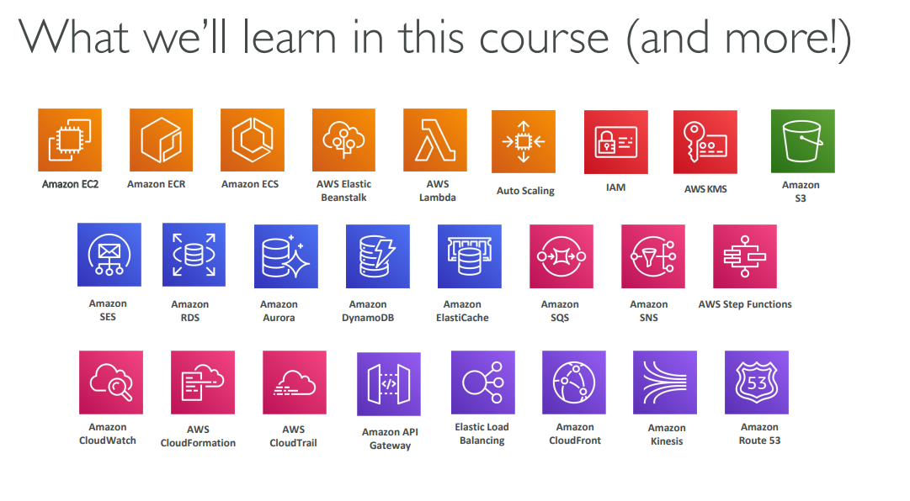

Slide 28
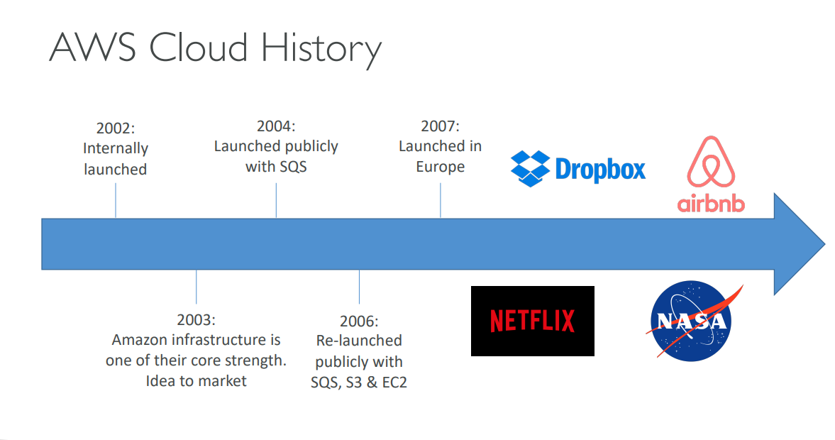

Slide 29
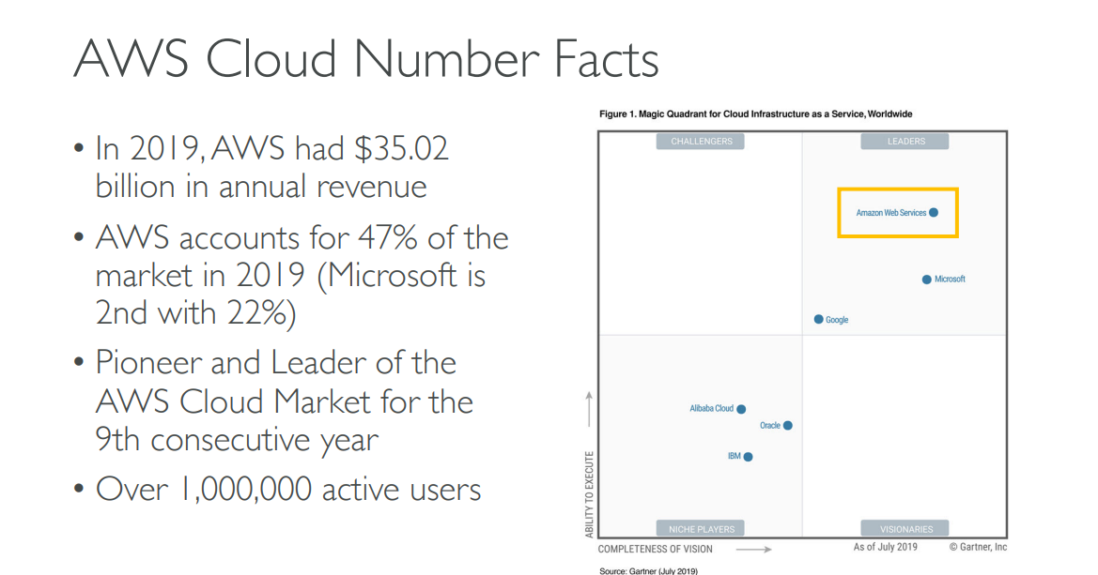

Slide 30
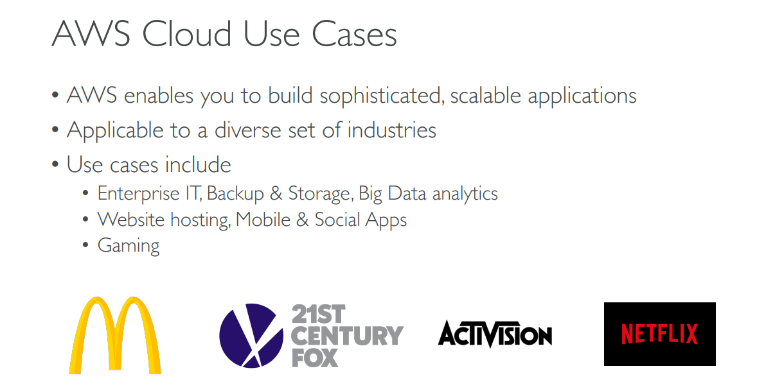

Slide 31
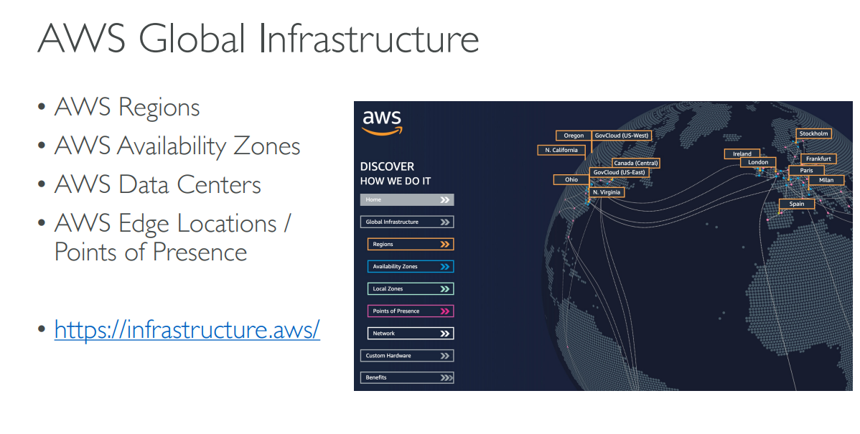

Slide 32
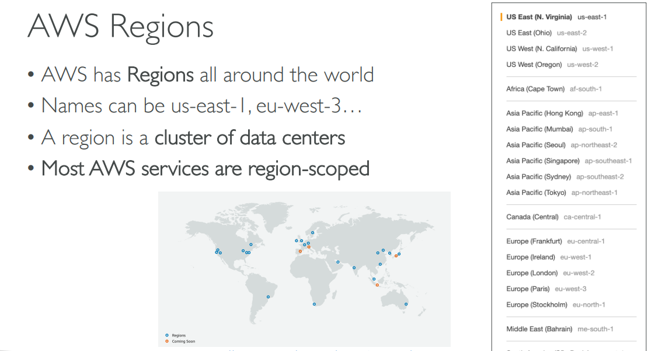

Slide 33
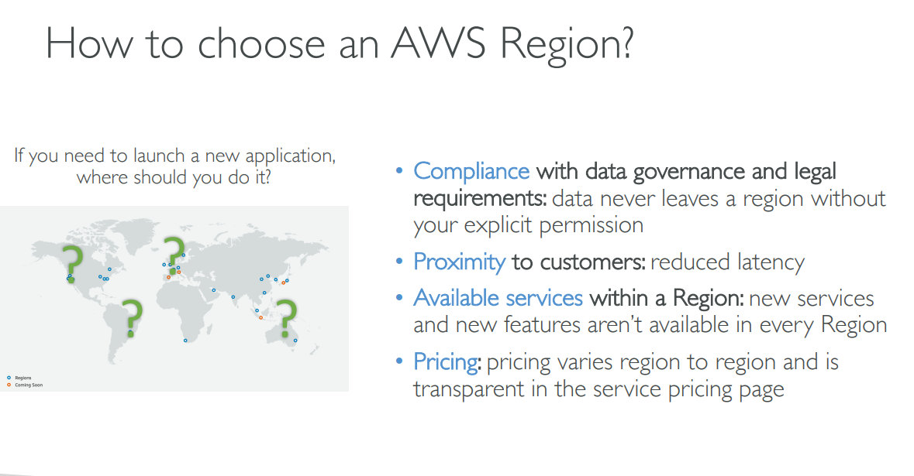

Slide 34
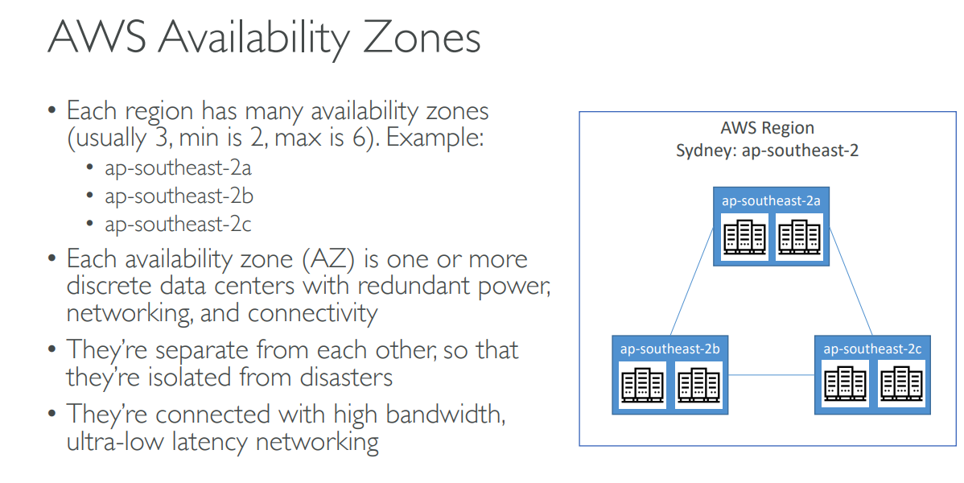

Slide 35
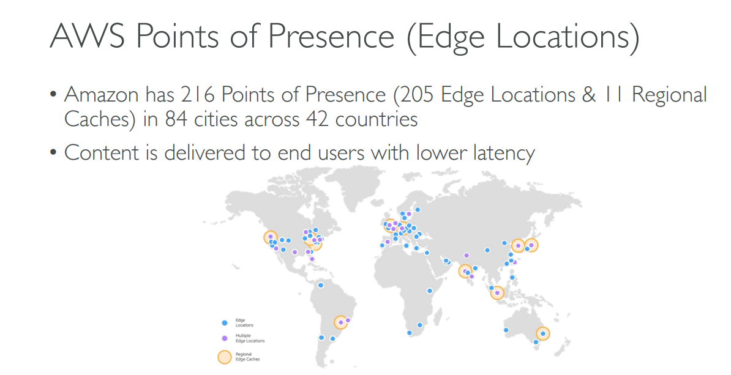

Slide 36
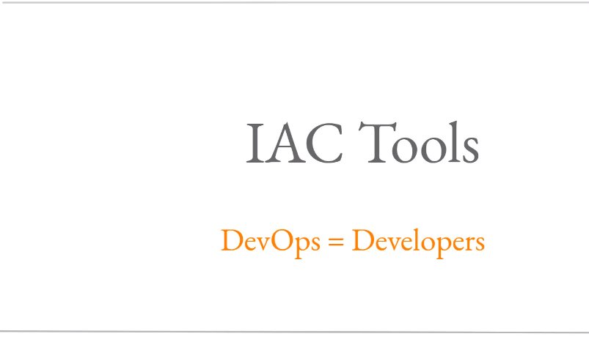

Slide 37
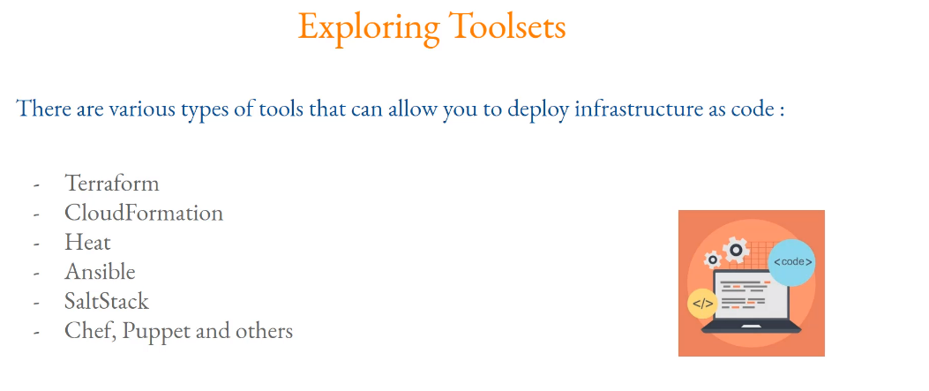

Slide 38
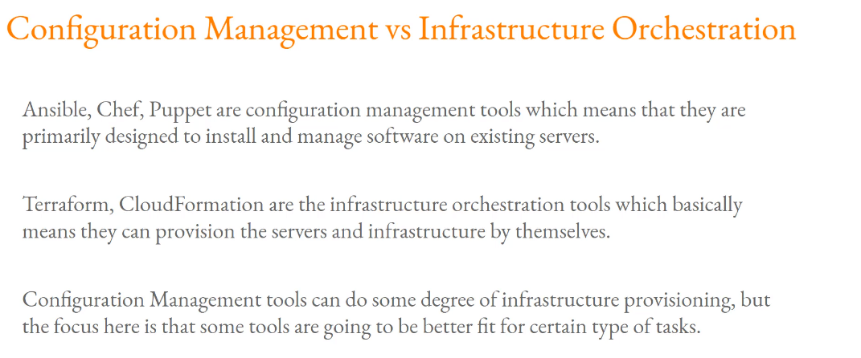

Slide 39
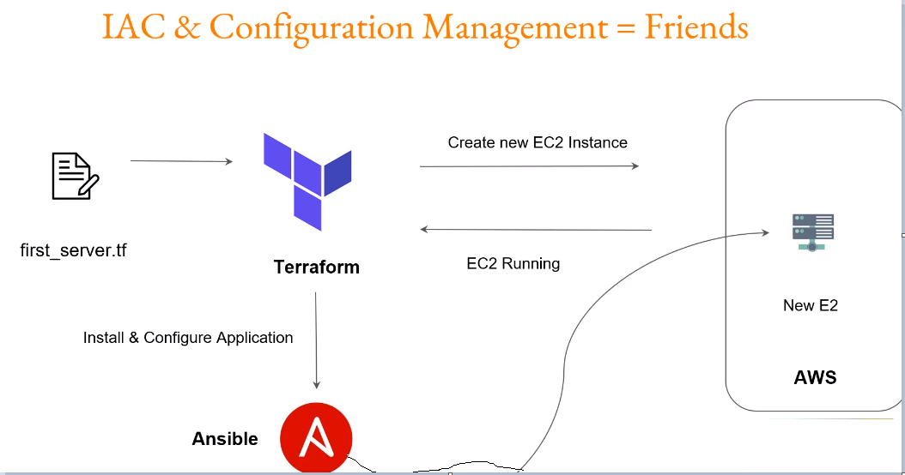

Slide 40
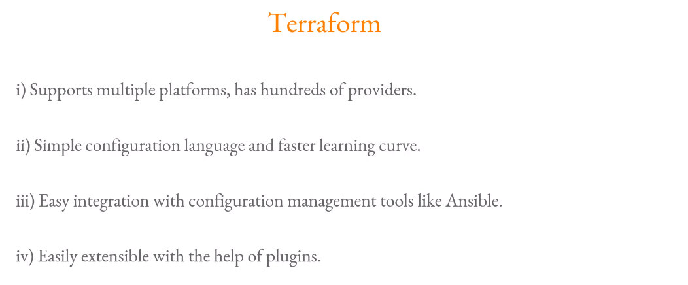

Slide 41
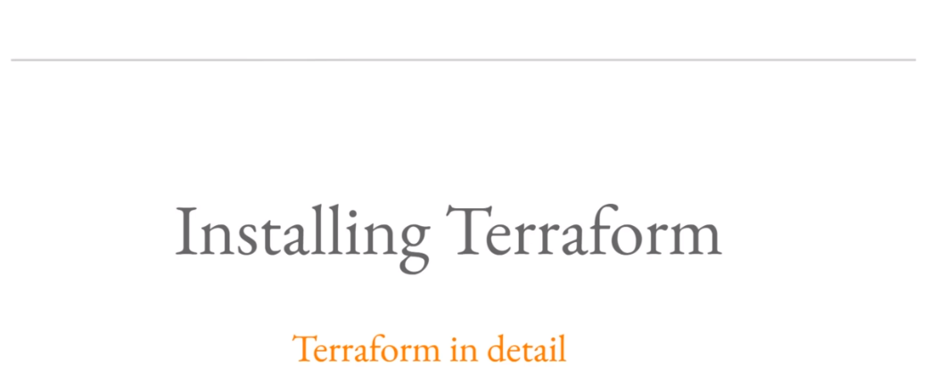

Slide 42
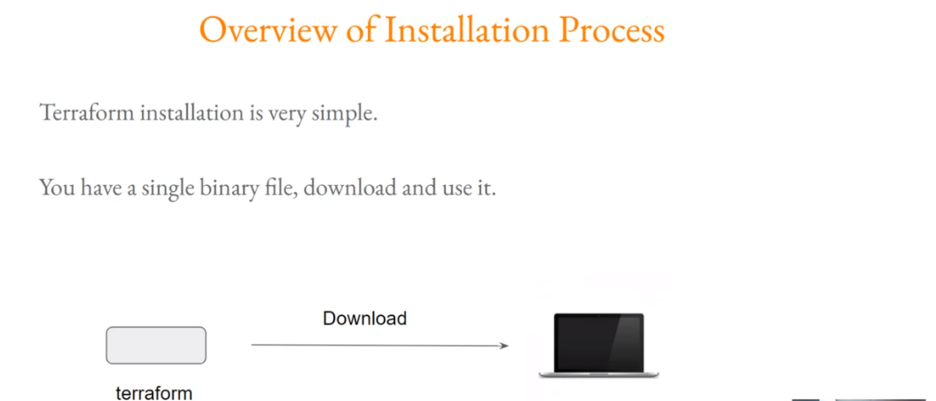

Slide 43
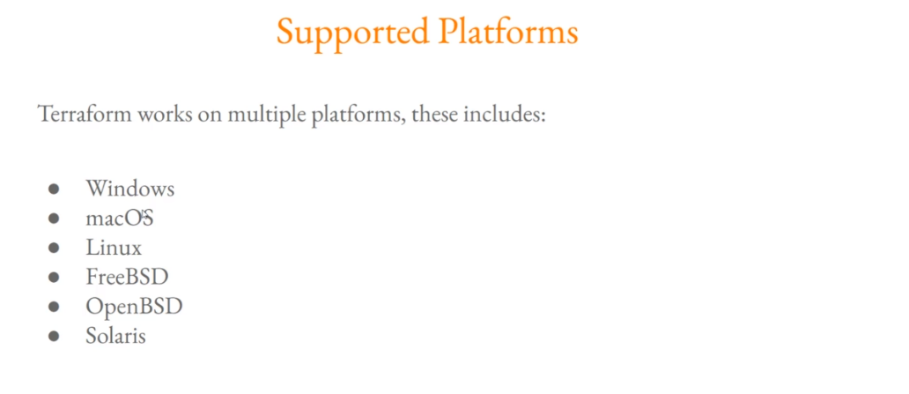

Slide 44
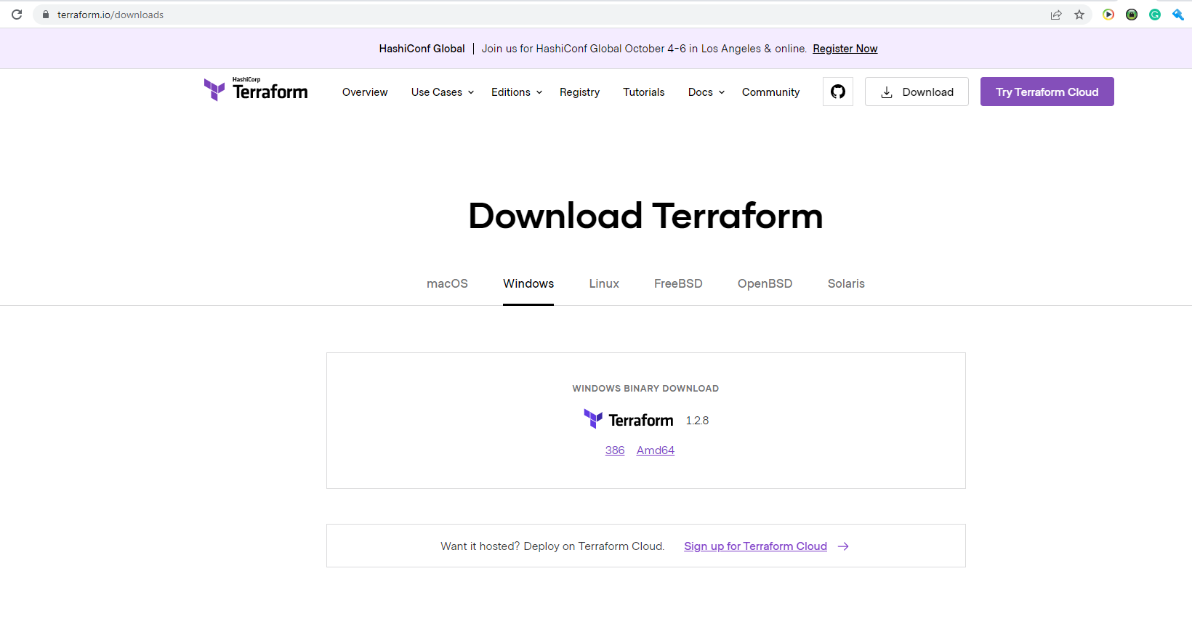

Slide 45
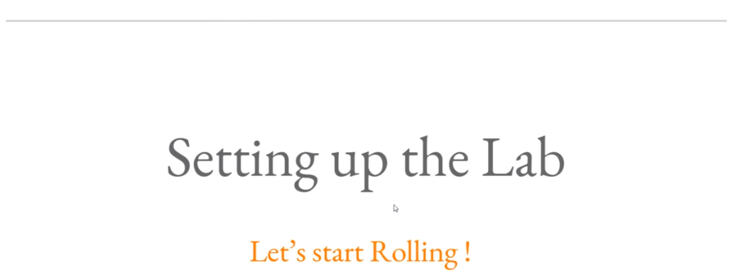

Slide 46
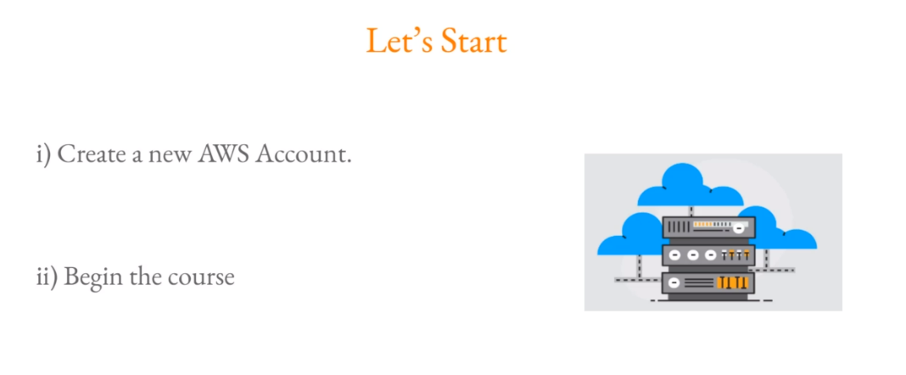

Slide 47
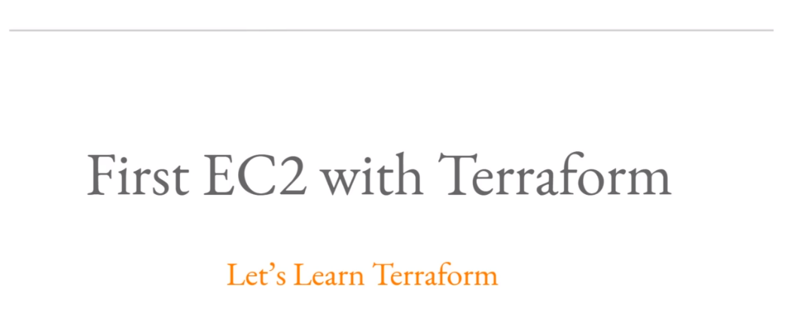

Slide 48
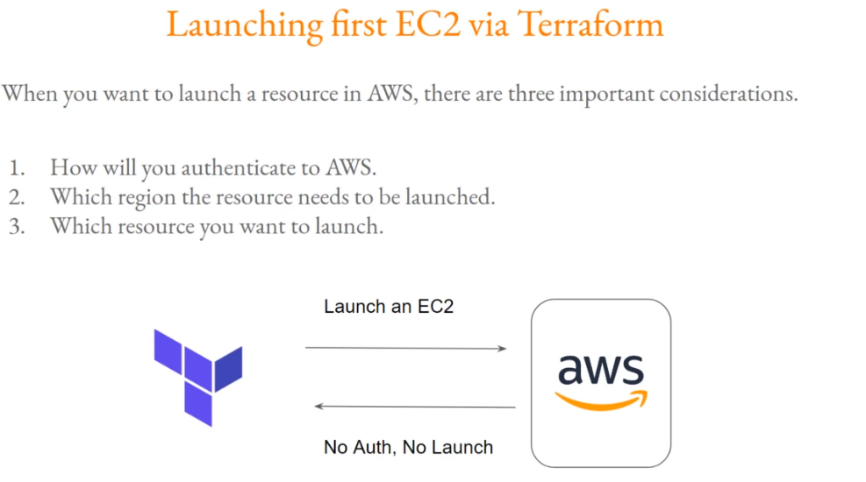

Slide 49
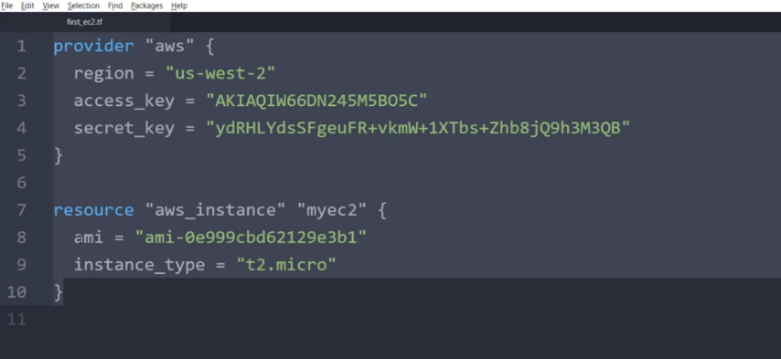

Slide 50


Slide 51


Slide 52



Slide 53


Slide 54


Slide 55


Slide 56


Slide 57


Slide 58


Slide 59


Slide 60


Slide 61


Slide 62


Slide 63


Slide 64
Ansible Introduction
Agentless Config Management over SSH
Python based (but you don’t need to know it)
YAML syntax for just about everything
Designed to be very simple

Slide 65
Ansible Playbook Components
Inventories (static or dynamic host groups)
Variables (different values for different envs)
Vault (a mechanism for encrypting secrets)
Tasks (pre tasks, tasks, and post tasks)
Roles (grouping of reusable tasks)
Handlers (provides orchestration of events)

Slide 66

Inventory
[webservers]
Web1
Web2
web3
[tomservers]
web4

Slide 67


Slide 68


Slide 69


Slide 70


Slide 71


Slide 72


Slide 73


Slide 74


Slide 75


Slide 76




AWS DevOps Hari Solution Architect Exp 10+ yrs (Realtime + Trainer)

Slide 77


Slide 78


Slide 79


Slide 80


Slide 81


Slide 82


Slide 83


Slide 84


Slide 85


Slide 86


Slide 87


Slide 88


Slide 89


Slide 90


Slide 91


Slide 92


Slide 93
Route table is helping your traffic will be routing through your vpc
Internet gateway is attached to my vpc and it gives internet access to EC2 Instances.

Slide 94


Slide 95


Slide 96


Slide 97


Slide 98


Slide 99


Slide 100


Slide 101
1. Create The VPC – DemoVPC – 10.0.0.0/16
2. Create Subnets like Public & private
1. PublicSubnetA : 10.0.0.0/24 , 2. PublicSubnetB : 10.0.1.0/24 ,3. PrivateSubnetA : 10.0.16.0/20
4. PrivateSubnetB : 10.0.32.0/20
3. Subnets attached to the VPC
4. Internet Gateway (IGW) EC2 instance in a VPC connect to the Internet
-> create EC2 Instance – Network settings ->VPC ->subnet -> auto-assign public IP -> default-> disable ->goto publicsubnetsA – select the auto assign – try to connect from web but not working due to IGW not added to DemoVPC
5.Create Internet Gateway name like DemoIGW -> state is Detached -> actions -> attache demovpc
6.Create Route Tables -> PublicRouteTable & PrivateRouteTable and assign it to vpc and -> subnet association – PublicRT to Public subnets & PrivateRT
Public routeTable – Routes – edit routes -> add 0.0.0.0/0 -> add demoigw -> save the changes and connect the instance

Slide 102


Slide 103


Slide 104



Slide 105



Slide 106


Slide 107


Slide 108


Slide 109


Slide 110


Slide 111


Slide 112


Slide 113


Slide 114


Slide 115


Slide 116


Slide 117


Slide 118


Slide 119


Slide 120


Slide 121


Slide 122


Slide 123


Slide 124


Slide 125


Slide 126


Slide 127


Slide 128


Slide 129


Slide 130


Slide 131


Slide 132


Slide 133


